Slide 1


Enhanced Precision in Anomaly Detection
An Optimized k-Means Clustering Approach
Huining Huang

Slide 2
Introduction
Anomaly Detection: Methods & Applications
Why It Matters:
Identifies errors, fraud, and new patterns in data.
Key Methodologies:
Statistical Methods: Spot deviations using statistical models.
Machine Learning-Based Methods: Supervised and unsupervised learning for complex data.
Proximity-Based Methods: Use distance metrics like DBSCAN for outlier detection.
Applications Across Domains:
Finance, Industry, Cybersecurity.
Considerations:
Balance between method complexity and data attributes.
Sources: [11-16]

Slide 3
Literature Review
Clustering-Based Anomaly Detection:
Overview & Methods
Significance in Sectors:
Cybersecurity, Healthcare, Finance
Primary Clustering Methods: Density-Based: DBSCAN
Distribution-Based: GMMs
Centroid-Based: K-means
Connectivity-Based: Hierarchical Clustering
Method Highlights:
DBSCAN: Detects sparse points in dense regions [1].
GMMs: Labels anomalies based on probabilistic distributions [2]. K-means: Outliers far from centroids [3].
Hierarchical: Small, detached cluster points [4].
Sources: [1-4]

Slide 4
Clustering-Based Anomaly Detection:
Analysis & Future
Comparative Analysis:
Density vs. Distribution: Flexibility vs. Probabilistic Models [1][2].
Centroid vs. Connectivity: Scalability vs. Detailed Structuring [3][4].
Challenges & Practical Applications:
Scalability and Parameter Sensitivity. Interpretability in Complex Models [2][4].
Utilized in Fraud Detection, Network Security [5][7].
Research Gaps & Future Directions:
Real-time data stream integration and interpretability [10]. Deep learning precision, e.g., Reverse Distillation [9].
Sources: [1-10]

Slide 5
K-means Based Anomaly Detection Algorithm: Overview
Anomaly Score:
Anomaly score A(x) defined by distance to cluster center, standard deviation, and density factor.
A(x) = ^{D(x,Ci)} × ρ(C_{i})
σ(C_{i} )+ϵ
Algorithm Steps:
Data Preprocessing: Standardization and imputation.
Determine Optimal Clusters k: Elbow method/silhouette score.
Centroid Initialization: Advanced methods (e.g., k-means++).
Clustering Execution: Using distance metric M .
Compute Cluster Properties: Standard deviation σ(C_{i}) and density factor ρ(C_{i}).
Algorithm continues on next slide...

Slide 6
K-means Based Anomaly Detection:
Execution & Post-Processing
Algorithm Steps Continued:
Anomaly Set Initiation: Initialize an empty set for anomalies.
Anomaly Scoring & Detection:
Assign points to nearest cluster. Calculate anomaly score.
Establish dynamic threshold T .
Append outliers to anomaly set A.
Post-Processing: Domain-specific filters or secondary model application.
Threshold Strategy:
Dynamic threshold T = α × median{A(D)} or percentile-based.
Post-Processing:
Enhances detection precision by mitigating false positives.
Final Output:
Refined set of anomalies A based on defined criteria.
End of Algorithm Presentation

Slide 7
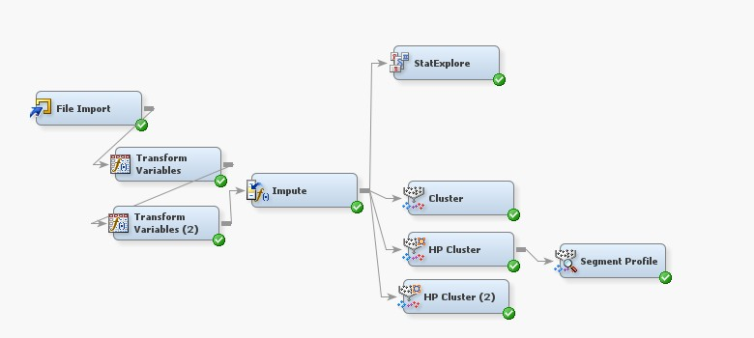
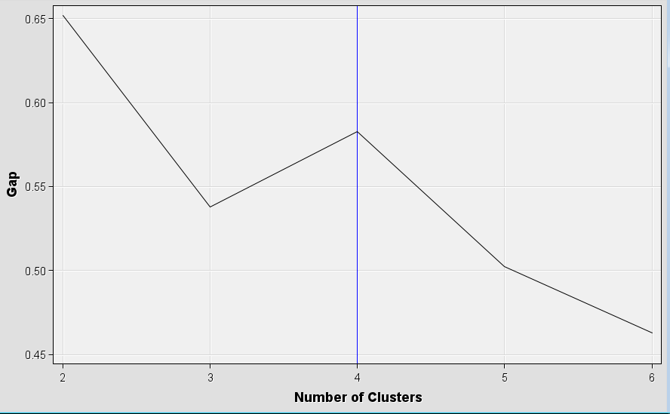
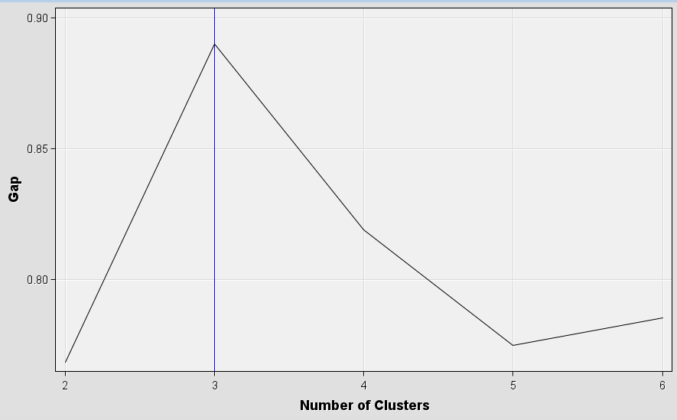
Algorithmic Implementation and Cluster Analysis
Figure 5: Gap Statistic plots for Euclidean and Manhattan distances (respectively), depicting optimal cluster determinations based on respective peaks.

Slide 8
Anomaly Detection Methodology
K-Means Anomaly Detection Framework
Initial clustering with SAS Enterprise Miner Transition to Python for enhanced anomaly detection
Anomaly score based on distance to centroid, cluster density, and deviation Dynamic thresholding to identify outliers
76 anomalies detected from the dataset
A(x) = ^{D(x,Ci)} × ρ(Ci), where D(x, Ci)
σ(C_{i} )+ϵ

Slide 9
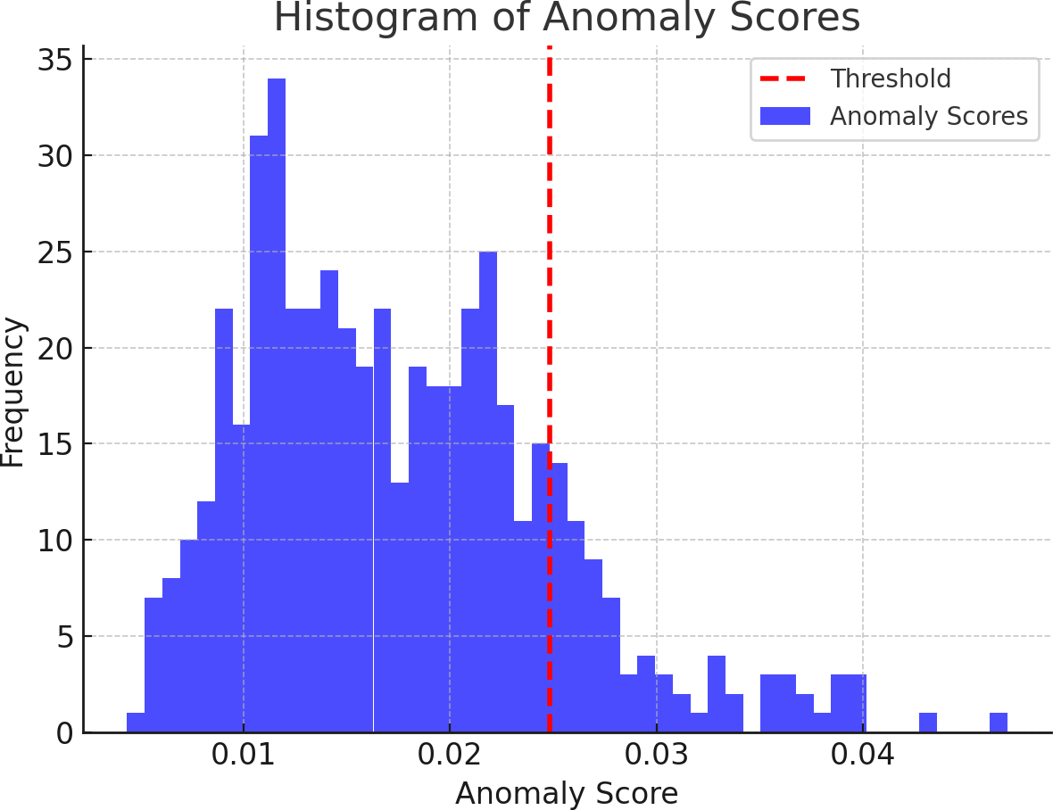
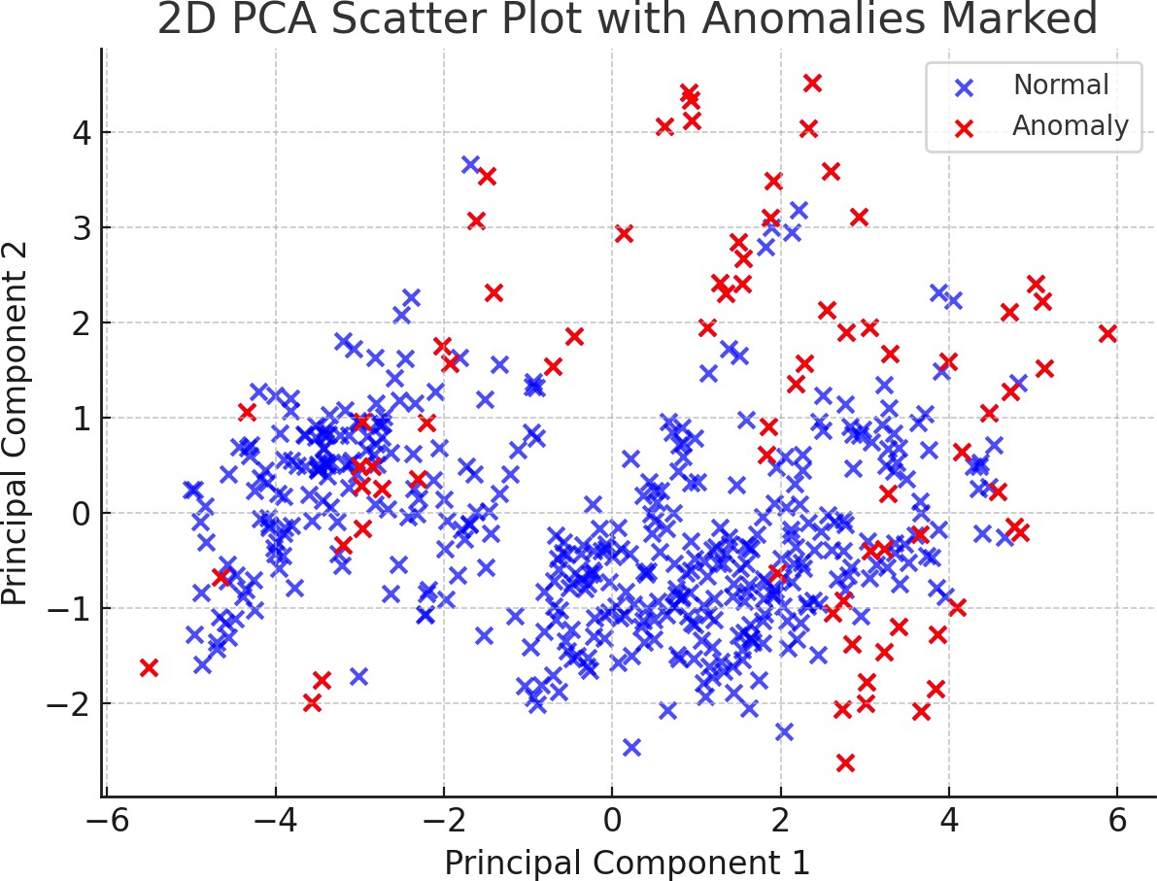
Insights from Anomaly Visualization
Dimensionality reduction using PCA for visualization Histogram of anomaly scores with threshold line
Scatter plot: normal data vs. anomalies Anomaly distribution table by cluster
Higher anomaly rates suggest potential subgroups
Cluster ID | Anomaly Count | Total Count | Anomaly Rate
1 | 49 | 141 | 34.75%
2 | 22 | 174 | 12.64%
3 | 5 | 191 | 2.62%

Slide 10
Analysis of Anomalies in
the Boston Housing Dataset
Attribute Contributions:
High NOX levels in anomalies.
Unusual PTRATIO and RM indicating rarity. Anomalies with lower TAX rates.
Practical Implications:
Anomalies with higher MEDV values. Varied CRIM rates among anomalies.
Algorithm Limitations:
Sensitivity to attribute extremes. Potential for false identifications.
Future Research:
Importance of contextual analysis.
Need for integrated valuation approaches.

Slide 11
References/Questions
Citing relevant literature and studies referenced in the paper. Open floor for questions and further discussion.

